Slide 1
3-dars(Model Building)
Davronbek Malikov

Slide 2
Vazifa
Built-in fun code warsga qollang
Project:
Built-in fun code Project qollang
Funksiya
Klib, autoclean(functiya va u siz compare, tabulate)

Slide 3

Bugun
Takrorlash
Qo’shimcha: Visual Kutubxonalar
Built-in functions
Project1
Vazifa

Slide 4
Takrorlash

Slide 5
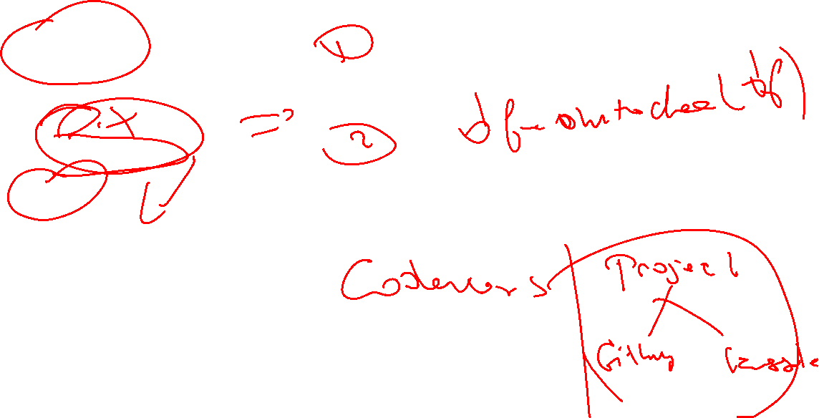
Takrorlash
Takrorlash
Yangi kutubxonalar
Klib
Datacleaner
Project

Slide 6

Built-in functions

Slide 7
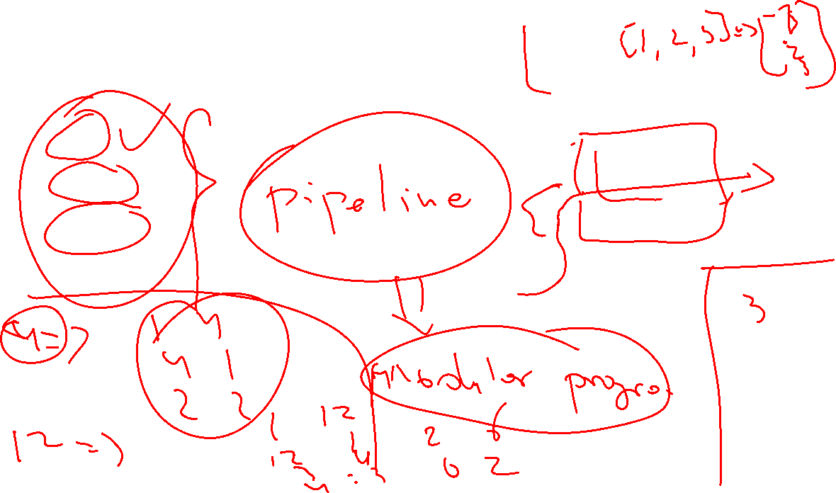
Built-in functions
List
Numpy
Pandas

Slide 8
Project1

